Slide 1
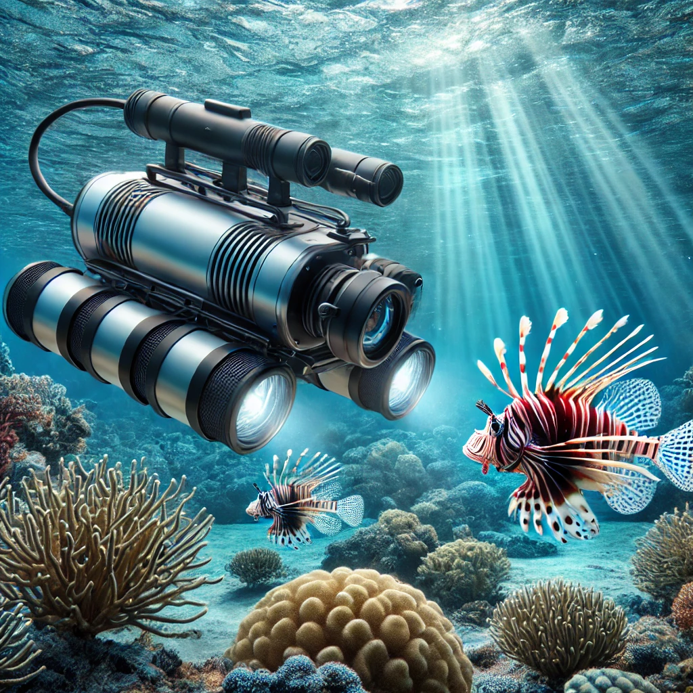
Reeflex: Underwater Leak Detection System
Omar Nayfeh

Slide 2
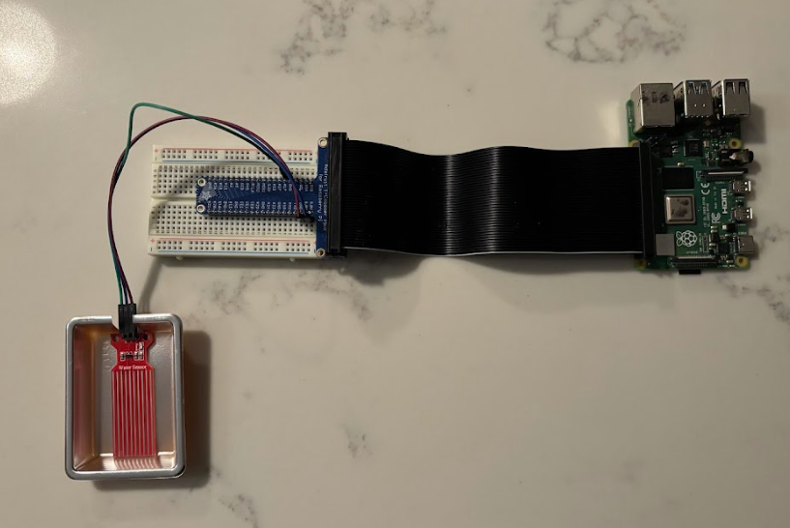
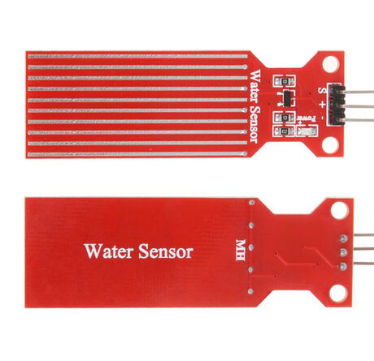
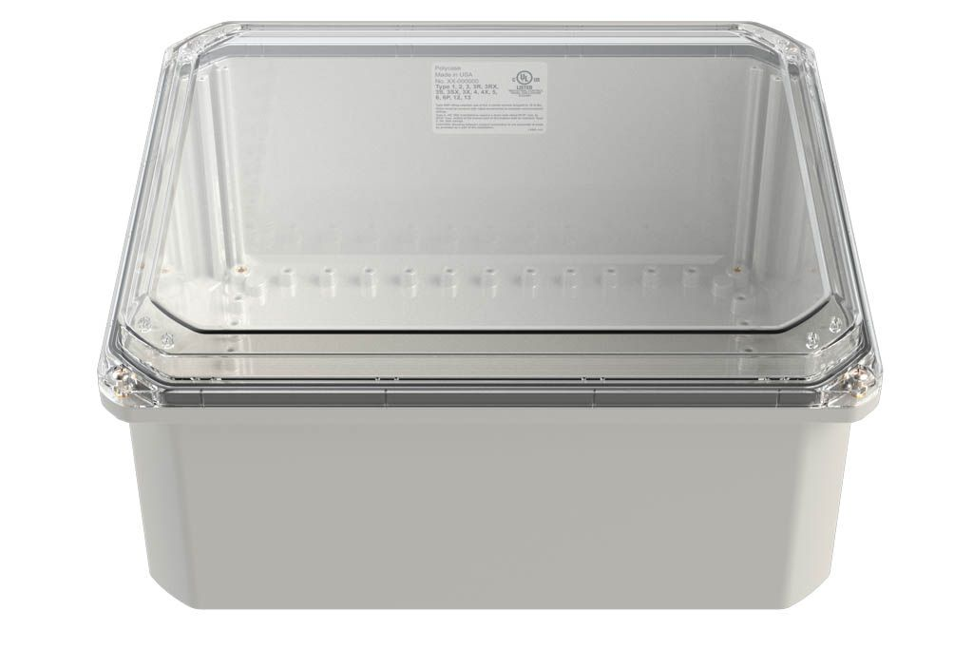
Introduction
Goal
Design an IOT system that can detect a water leak in an underwater electronics box and immediately notify the user
Motivation Behind the Project
REEFLEX ROV is designed to be submerged underwater for several hours
The watertight container houses components that are essential toward functionality
Watertight seals are far from perfect, especially given the influx of wires in and out of the container
The project will be specifically configured for Capstone but could be utilized as a stand alone product
Task Breakdown
Identify and acquire needed sensor(s)
Write a program that will be able to sense a water leak and notify the user
Optimize sensor placement and configuration within available space
Hardware
Raspberry Pi:
Model: 2018 Raspberry Pi 4
Model B
Water Sensor:
Model #: KZY3446
Waterproof Container:
Model#:ZQ-141206-93

Slide 3
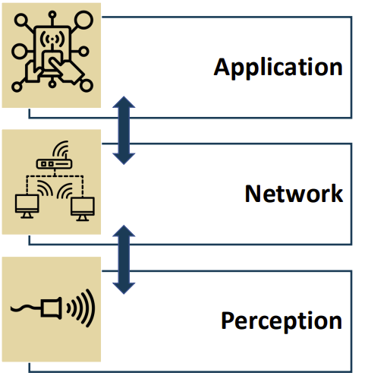
3-Layer IOT Model
Python Script sends an email as soon as water is detected
Pi outputs sensor data via tethered ethernet connection
Water sensor fixed to container bottom surface

Slide 4
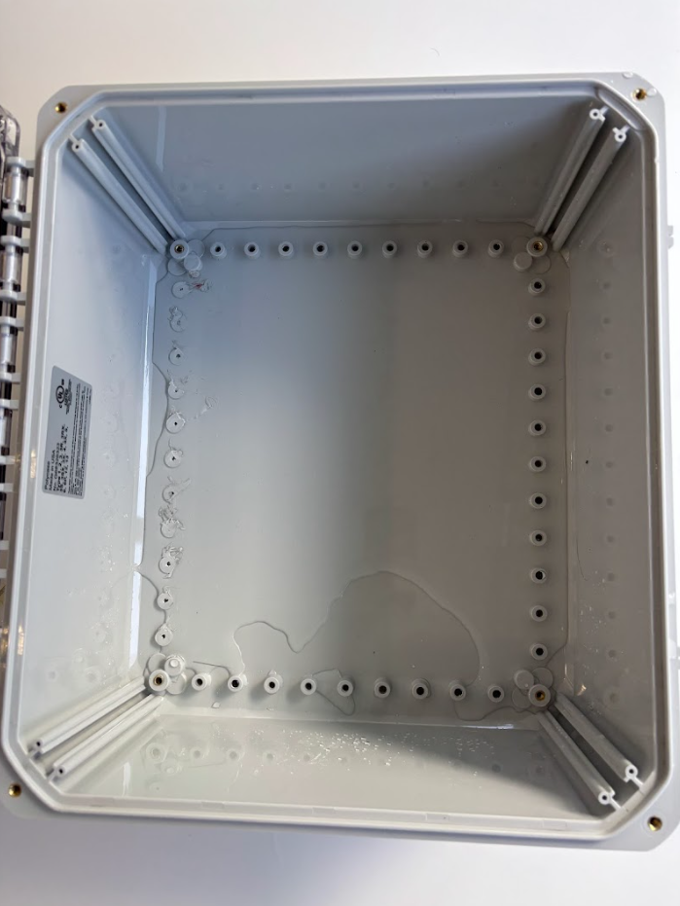
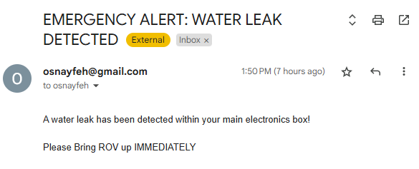
Results and Conclusions
System detected water and sent out an alert rapidly
The water sensor is highly sensitive to even the smallest drops of water
Testing was done on the waterproof box to optimize placement based on puddling and leak points (surface was quite level)
As tested, the project successfully did what it was tasked and exceeded expectations in detection
With proper integration, the project could potentially save hours of work and thousands of dollars
Placement: a majority of cables will be leaving from the top section mainly due to battery placement. In the remaining space, electronics will be placed on shelves. The water sensor will be placed within the highlighted section flush with the surface of the bottom of the box.

Slide 5
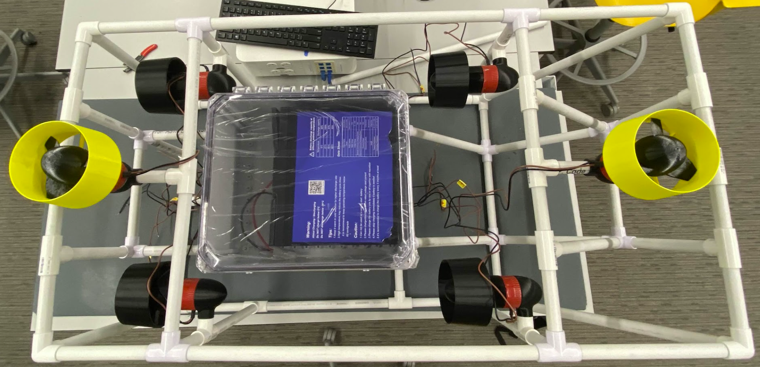
Final Steps
Once all other electronics are fully integrated within electronics box, and all cables are finalized leading into and out of the box, placement of the water sensor can be finalized (3/20)
I am currently working under the assumption that we will have a raspberry pi for other computation on board, which could then easily integrate my project (3/20)
If not, a raspberry pi can easily be added into the system, powered via the in-compartment battery connected to the internet via ethercat (3/25)
References:
Bulusu, K. (2025). MAE 6291: Internet of Things for Engineers – Week 5 Lecture Slides. MAE Department.
Global Sources. (n.d.). Hot sale electronics water sensor. Retrieved March 4, 2025, from https://www.globalsources.com/Fluid-level/Hot-Sale-Electronics-Water-Sensor-1209535495p.htm
Polycase. (n.d.). ZH-141206 enclosure. Retrieved March 4, 2025, from https://www.polycase.com/zh-141206#ZH-141206-08

